Slide 1
Experiment II：
Turbo Code

Slide 2
Introduction
Turbo codes are a class of high-performance Forward Error Correction Codes (FEC) developed in 1993.
These codes are derived from parent convolution codes. Turbo codes uses Recursive Systematic Convolution (RSC) Encoder and Iterative BCJR (Bahl-Cocke-Jelinek-Raviv) decoder.
Its performance is much better than the corresponding convolution code.

Slide 3



Log Likelihood Ratio
Coded sequence:
Received sequence:
A posteriori log likelihood ratio (LLR) of

Slide 4
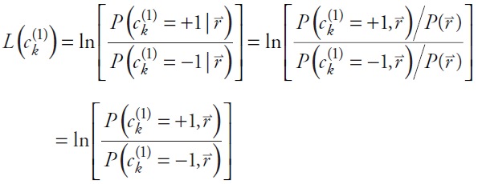

Log Likelihood Ratio
A posteriori log likelihood ratio (LLR) of

Slide 5

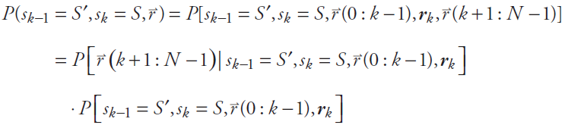
Log Likelihood Ratio
Let us break the received sequence r into three pieces, one containing the past, another the present (i.e., time k), and the third the future :
We then have:

Slide 6
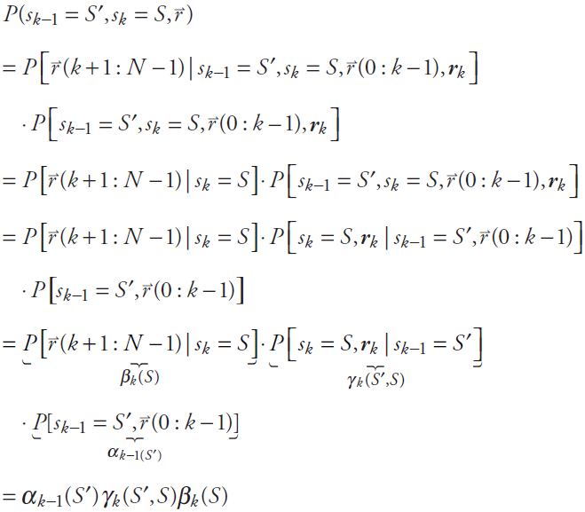

Slide 7


Log Likelihood Ratio
Log likelihood ratios, using the symbol λ
The likelihood ratio:

Slide 8
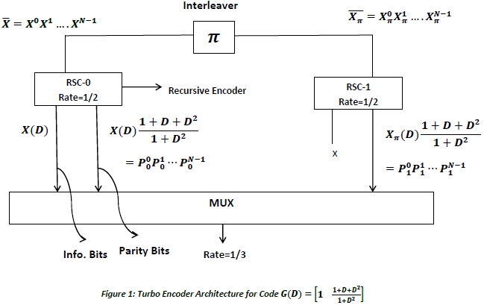
RSC Turbo Encoder:
Turbo encoder is comprised of 2 Rate ½ RSC encoder as shown in Figure 1.

Slide 9


RSC Turbo Encoder:
Encoding for each Rate ½ RSC encoder (RSC-0 & RSC-1) is done as follows:
Let

Slide 10
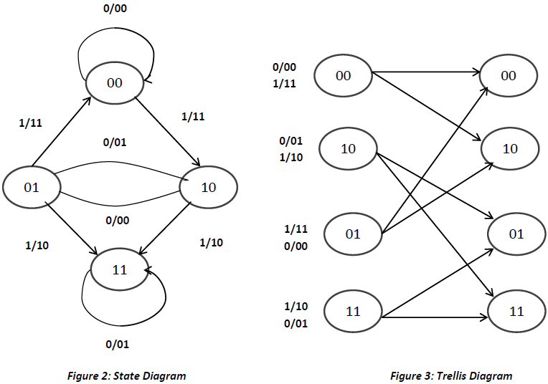
RSC Turbo Encoder:
the state diagram (Figure: 2) and Trellis Diagram (Figure: 3) are obtained

Slide 11
RSC Turbo Encoder:
Parameter declaration
Encoding
Result

Slide 12
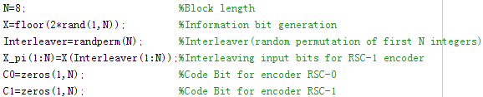
RSC Turbo Encoder:
Parameter declaration
Encoding
Result

Slide 13
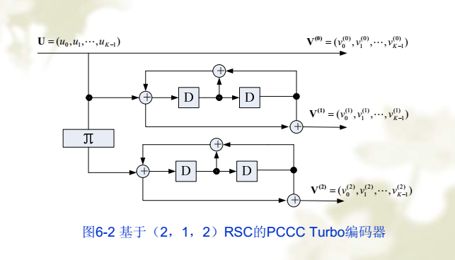

Slide 14
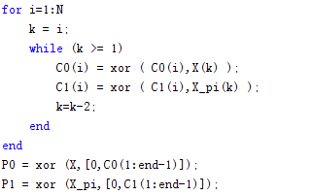
RSC Turbo Encoder:
Parameter declaration
Encoding
Result

Slide 15
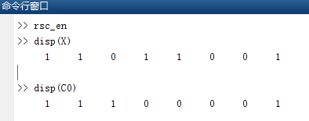

Slide 16
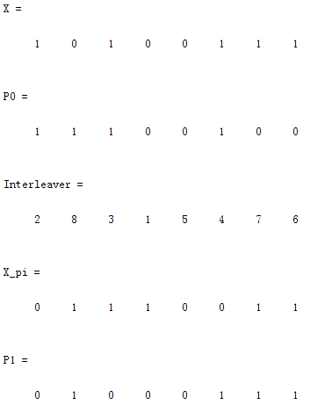

Slide 17


BPSK modulation
Modulation using BPSK modulation:
j=0,1,…,N-1
Transmission through AWGN channel
For j=0,1,….,N-1 and i=0,1,2. Here P is signal power. Noise variance is assumed to be unity.

Slide 18
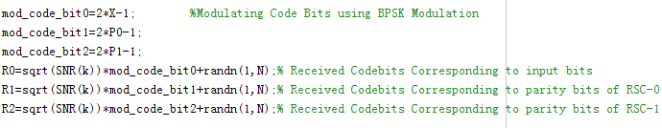
BPSK modulation

Slide 19
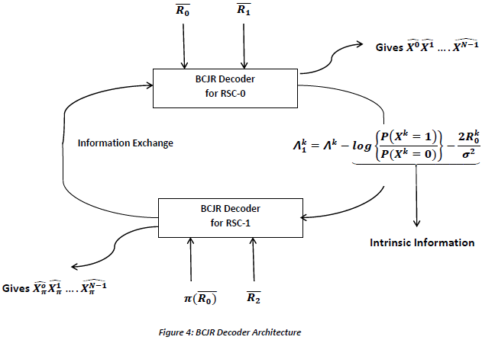
Decoding of received codewords
BCJR decoder Architecture is shown in Figure: 4.

Slide 20


Decoding of received codewords
We define Log A Posteriori Probability Ratio(LAPPR) as follows:
For k=0,1,….N-1. is the input to any of the decoder.
It can be shown that
Where i=0 or 1 (input), m and m’ are stages ( ), M is the total number of stages. Stage m=0, 1, 2 and 3 respectively represents stage 00, 01 10 and 11.

Slide 21




Decoding of received codewords
is forward state metric
Solving gives
is transition probability from state m’ to m at stage k for input i

Slide 22



Decoding of received codewords
is backward state metric
Solving gives

Slide 23
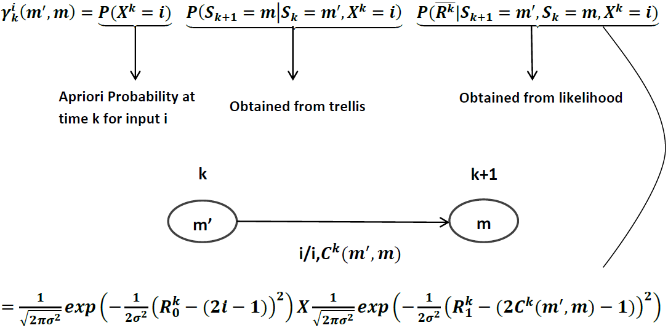
Decoding of received codewords

Slide 24
Algorithm Design
After receiving transmitted bits at the receiver with Additive White Gaussian Noise (AWGN), we start with initializing apriori probabilities to 0.5 for both input 0 and 1.
Similarly β probabilities are initialized at the final stage i.e. N-1, Where N is block length.

Slide 25

Algorithm Design
Then we calculate ϒ probabilities at all stages for both inputs.
ALPHA=zeros(4,N) Each column is for states 00,10,01and 11 respectively.
The initialization of α probabilities for first stage is done assuming encoder to be in state 00 initially.

Slide 26
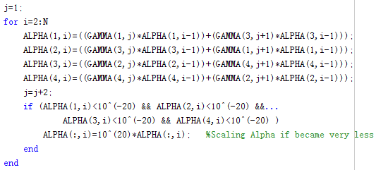
Algorithm Design
Then we use recursive relation of α to calculate α of next stage.

Slide 27

Algorithm Design
Similarly β probabilities are initialized at the final stage i.e. N-1, Where N is block length.
BETA=zeros(4,N) Each column is for states 00,10,01and 11 respectively.
We assume the next encoder to be in state 00 at start.

Slide 28
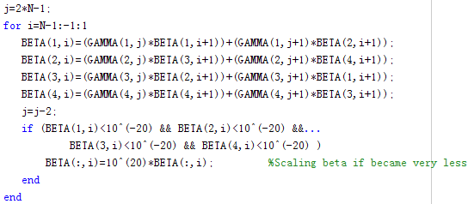
Algorithm Design
We use recursive relation of β to calculate β of next stage.

Slide 29
Algorithm Design
We use recursive relation of ϒ to calculate ϒ.
g=zeros(4,2*N);
At each stage(fixed k), there are 2 columns, 1st for i/p0 and 2nd for i/p1. The 4 entries for 1st columns are trasitions from 00 to 00, 10 to 01,01 to 10, 11 to 11 respectively and for 2nd column transitions from 00 to 10, 10 to 11, 01 to 00, 11 to 01 respectively

Slide 30
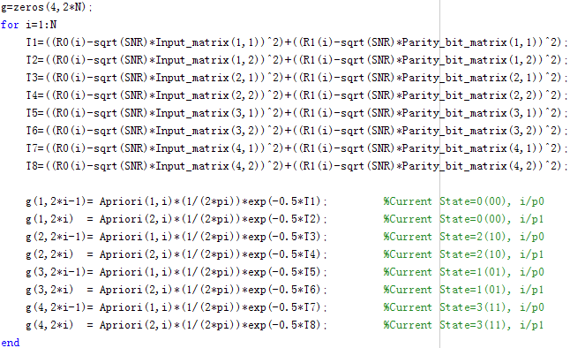
Algorithm Design

Slide 31
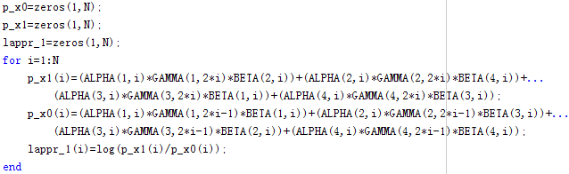
Algorithm Design
Calculates LAPPR at each stage.

Slide 32

Algorithm Design
After calculation of α, β, and ϒ the ratio is calculated for all stages.
Observing the values of , whether they are positive or negative the bits are decoded into 1 and 0 respectively.

Slide 33
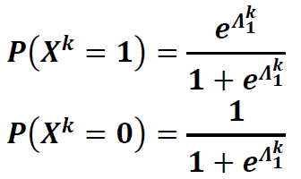
Algorithm Design
After the first iteration the first decoder (BCJR-0) passed values to second decoder excluding intrinsic information.
The second decoder uses these probabilities to calculate priory probabilities at all stages using the following relation:

Slide 34
Algorithm Design
The second decoder repeats the same process to decode the bits.
In simulation this iterative process is terminated when Priory Probability for one of the input becomes 1.

Slide 35

Simulation Results
For the simulation I have used N=10 thousand bits of information and varied SNR from 0 dB to 9 dB.
Total time taken for 4 iterations and all values of SNR ranging with an increment of 0.5 dB
Plot for comparison of performance of Turbo code and convolution code is shown .
The expression used for theoretical union bound on BER for parent convolution code is following

Slide 36
Simulation Results
From the plot it can be concluded that performance of Turbo decoder drastically improves compared to convolution code.

Slide 37

Excise
Consider the transfer function incorporated in the turbo encoder, which over AWGN channel for BPSK modulated symbols. Decoding of received codewords at the receiver using BCJR algorithm.
Compared the convolution code experiment with turbo code experiment.(notice : same memory and same rate )

